Slide 1

Final Project
Deep Learning Approaches for Protein Sequence Modeling using ProGen and ProTrans

Slide 2
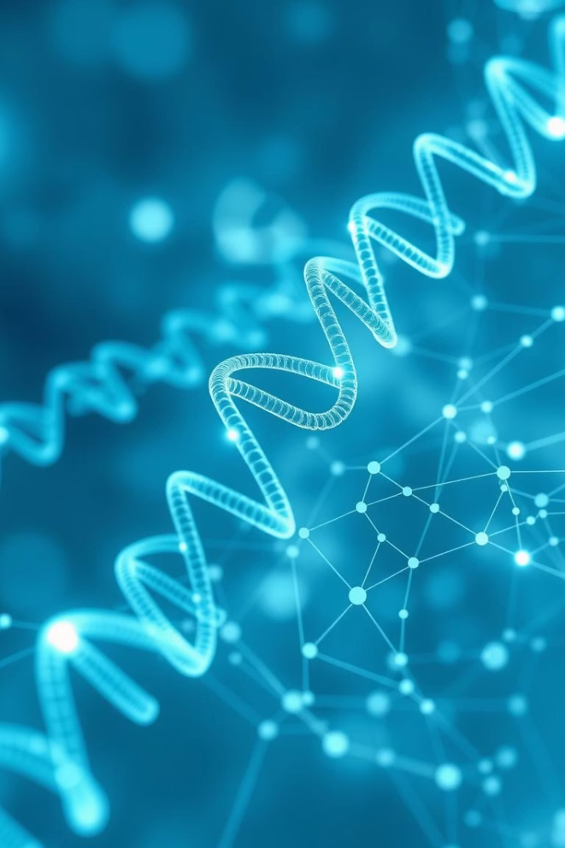
ProGen: Language Modeling for Protein Generation (Paper 1)
Problem Statement
How can we harness the vast collection of unlabeled protein sequences to train a generative model that produces novel, functionally viable proteins—without relying on expensive structural data—by treating amino-acid chains as a language?
Objective
Our research bridges computational biology with machine learning to enable the generation of novel protein sequences without relying on costly structural annotations. By treating protein sequences as a form of language, we've developed an unsupervised learning approach that could revolutionize synthetic biology, medicine, and material science.

Slide 3







Protein Engineering Challenge
Novel Solutions
Addressing challenges in medicine, biology, and materials
Limited Structural Data
Expensive and time-consuming annotation processes
Vast Sequence Space
~280M unannotated protein sequences available

Slide 4
Language Models for Protein Design
Traditional Approaches
Language Modeling Approach
Previous protein design methods have relied heavily on:
ProGen's innovative methodology:
Physics-based modeling
Treats amino acid sequences as "text"
Homology modeling
Learns patterns across diverse proteins
Experimental directed evolution
Enables unsupervised learning
Structure-based computational design
Requires no structural annotation
These approaches typically require structural information and are computationally intensive.
This approach dramatically expands the available training data by incorporating sequences lacking structural information.

Slide 5




Methodology & Implementation
Dataset Preparation
Collection of ~280M protein sequences from UniProt databases with taxonomic and keyword annotations
Model Architecture
1.2 billion parameter transformer-based language model
Conditional Training
Sequence generation conditioned on taxonomic and functional tags

Slide 6




Results and Analysis
Primary Sequence Similarity
Secondary Structure Accuracy
Conformational Energy
Generated sequences exhibit close similarity to natural proteins, indicating effective capture of evolutionary patterns.
Structure prediction methods confirm that generated sequences preserve biologically plausible folding motifs.
The conformational energy landscapes indicate stability of generated proteins comparable to natural counterparts.

Slide 7




Key Takeaways and Future Work
Unprecedented Scale
ProGen demonstrates the value of large-scale language modeling in capturing protein sequence-function relationships.
Contextual Control
Conditioning on biological tags enables fine-grained control for targeted protein generation.
Future Directions
Integrating structural predictions and experimental validation will enhance utility for de novo protein engineering applications.

Slide 8
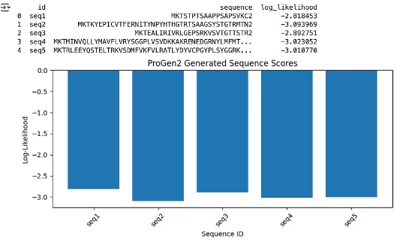
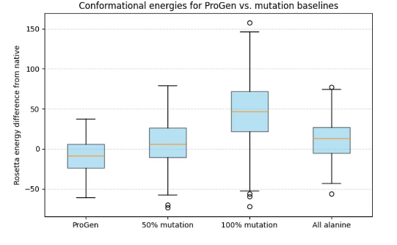
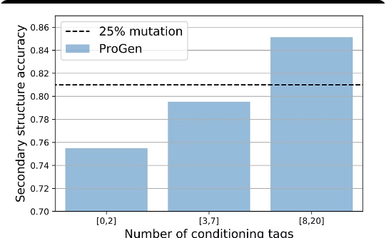
Visualizations in Protein Language Modeling
Model Architecture Overview
Sequence Similarity Analysis
Protein Structural Predictions
Diagram illustrating the transformer architecture and conditioning process with biological tags for sequence generation.
Heatmap representing alignment scores between generated sequences and natural protein databases.
Visualization of predicted secondary structures and energy landscapes confirming protein stability.

Slide 9

Conclusion and Impact of ProGen
ProGen represents a paradigm shift in protein engineering by using language models to generate functional protein sequences at scale. By leveraging massive unlabeled sequence data and biological metadata, it enables precise, context-aware protein design that can accelerate synthetic biology and therapeutic discovery. The integration of language modeling with biological knowledge has broad implications for computational protein generation, potentially reducing reliance on costly experimental annotations while broadening the scope of designable proteins.
Future experimental validations and hybrid computational-structural approaches will likely unlock further capabilities, driving transformative advances in protein engineering sciences.

Slide 10
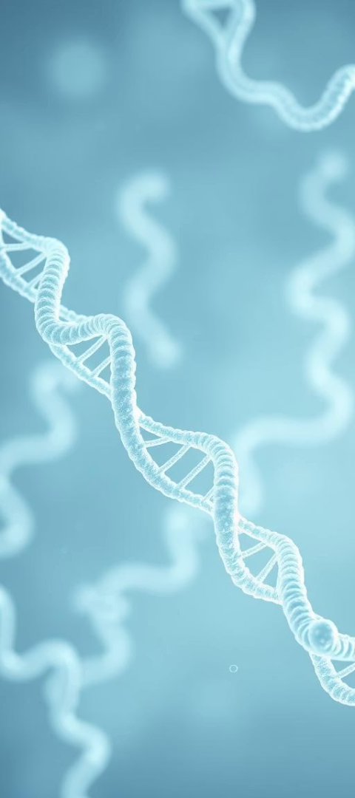
ProtTrans: Cracking the Language of Life's Code with Self-Supervised Deep Learning (Paper 2)
Problem Statement
Understanding protein sequences is fundamental to biology and medicine. ProtTrans leverages self-supervised deep learning and high-performance computing to decode protein language, aiming to transform protein engineering and design. This presentation explores the challenges, methodology, and groundbreaking results of ProtTrans, a novel approach that applies natural language processing techniques to protein sequences to uncover structural and functional insights.

Slide 11

Protein Engineering Challenge
Challenge in Protein Engineering
Protein sequences encode complex biological functions, yet their translation into structure and function remains difficult. Traditional computational methods fall short in capturing this complexity due to non-linear and high-dimensional dependencies.
Research Objective
To apply self-supervised deep learning models, inspired by language models, to decipher protein code and create embeddings that facilitate protein function prediction, structure annotation, and engineering.

Slide 12
Language Models for Protein Design
Transformer-Based Models
Self-Supervised Learning
Embedding for Protein Features
ProtTrans employs transformer architectures initially developed for natural language processing, treating protein sequences as textual data with semantic context.
Using unlabeled protein sequences, models predict masked amino acids, learning rich sequence representations without curated annotations.
The learned embeddings capture structural motifs, evolutionary relationships, and biochemical properties, enabling downstream prediction tasks.

Slide 13
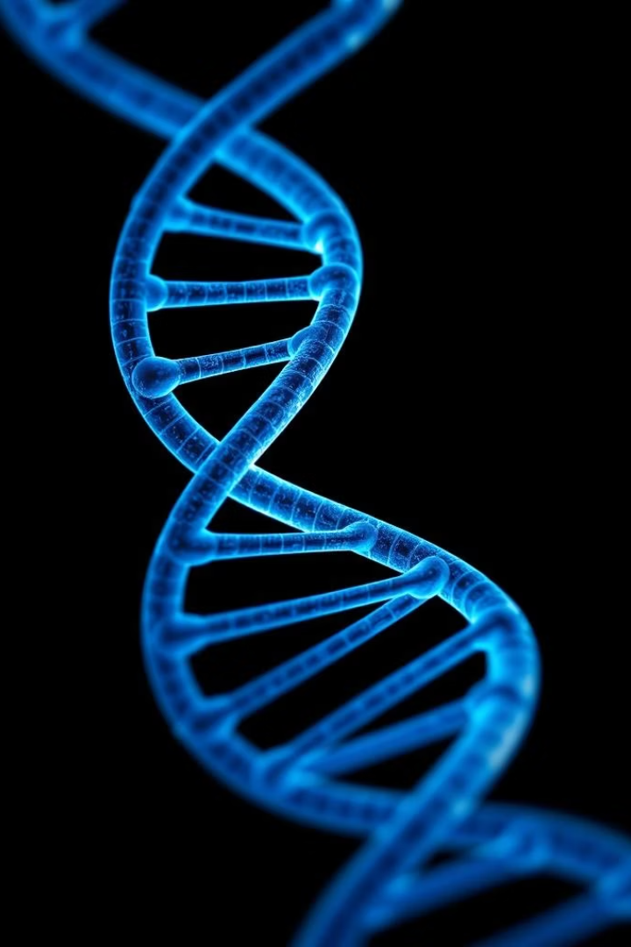
Methodology & Datasets
Datasets Used
Implementation Details
UniRef50 and UniRef100: large-scale protein sequence databases ensuring diversity and non-redundancy
Training on high-performance clusters to accommodate model size and data volume
Merged datasets contain billions of amino acid residues, facilitating deep representation learning
Masked language modeling objective with varied masking strategies
Multiple transformer architectures including BERT, XLNet, and T5 adapted for protein data

Slide 14
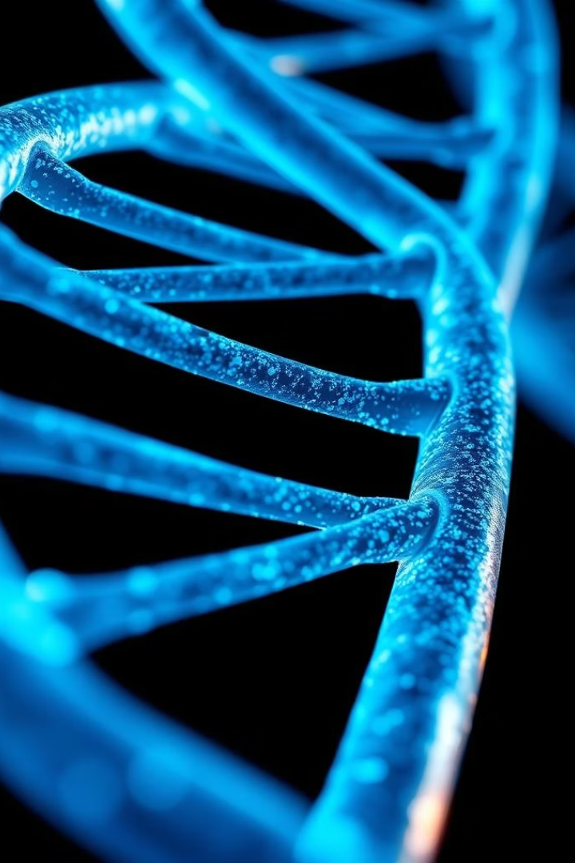
Results and Analysis
Enhanced Protein Feature Prediction
Transferability Across Tasks
ProtTrans embeddings outperform previous methods on various benchmarks, including secondary structure and binding site prediction.
Models demonstrate robust generalization, enabling applications in mutation impact prediction and design of novel proteins.
Computational Efficiency
Use of high-performance computing significantly reduces training time without sacrificing accuracy, enabling scalability.

Slide 15

Key Takeaways and Future Work
Insights
Challenges Ahead
Future Directions
Protein sequences can be effectively modeled as language using transformers, providing rich semantic representations for bioinformatics.
Addressing interpretability and integrating structural data remain critical. Adapting models to emerging protein families and annotations is necessary.
Combining multimodal data, enhancing model explanations, and applying ProtTrans embeddings to protein design automation are promising areas.

Slide 16
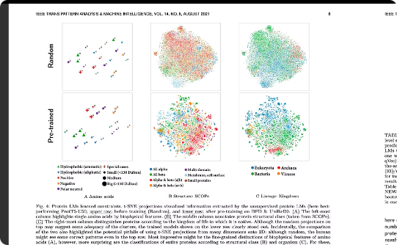
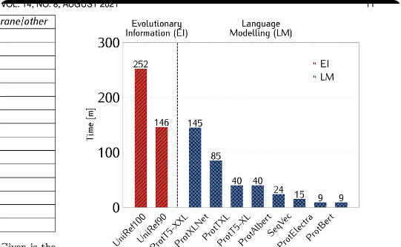
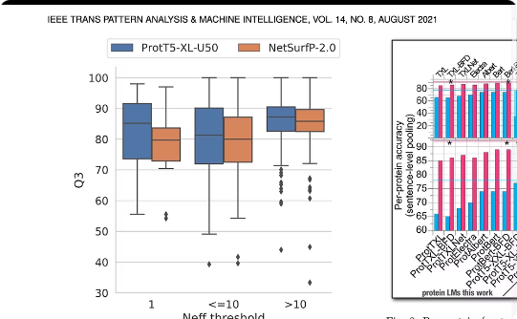
Visualizations Supporting ProtTrans Research
Protein Sequence Complexity
Transformer Architecture
Training Pipeline
The intricate layout illustrates the diversity and complexity of amino acid sequences ProtTrans models to learn contextual relationships.
Visualization of the deep learning architecture tailored for protein sequences, highlighting attention mechanisms and multilayer processing.
Diagramming the end-to-end training process, from dataset preparation to model optimization via HPC infrastructure.

Slide 17
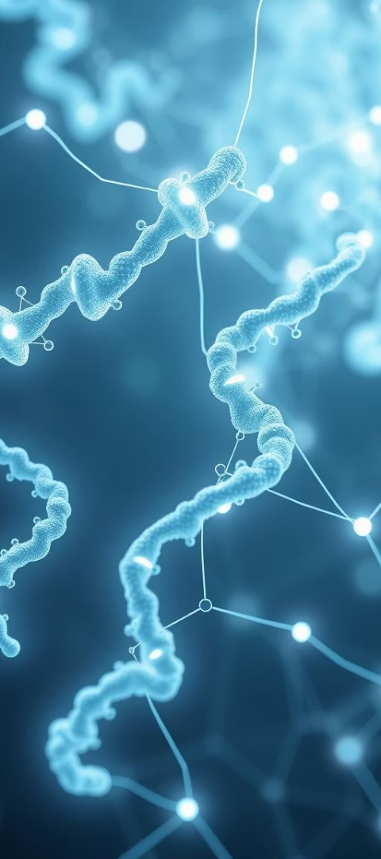
Conclusion and Impact of ProtTrans
ProtTrans marks a significant leap in computational biology by successfully bridging protein science with self-supervised deep learning. It establishes a scalable framework that unlocks protein language understanding, enhancing predictions of protein structure and function. This advancement empowers protein engineering, drug discovery, and synthetic biology, heralding a paradigm shift in how protein data is analyzed and leveraged.​

Slide 18

THANK YOU!
Janhavi Patil
Raghavendra Prasath Sridhar
Gunashree Rajakumar

